Slide 1
Traveler planning problem
Linyu yao
hanyuan zhang
taoyouwei gao

Slide 2
1. Project introduction

Slide 3
Project Introduction
In this project, we try to solve a traveler planning problem through a model of undirected weighted graph. It is assumed that a man plans to travel around several cities, return the original city, and only visit every city for once. There are three transportation methods that he can choose including: flight, railway, and highway. Our goal is to choose a most economical transportation method between every two cities according to different money and time cost weight. And we will calculate the shortest path for the whole trip. In other words, we can get a travelling route, which is the most efficient and economical consistent with the users’ requirement.

Slide 4
Project Introduction
Atlanta Los Angeles Seattle New York
Washington Boston Chicago Hawaii
San Francisco Las Vegas Houston
Philadelphia San Diego Miami

Slide 5
2. Part One

Slide 6
Part One
Input file: longitude and latitude of every city
positive numbers of longitude represents north
negative numbers of latitude represents west
Table 1: longitude and latitude of every city
City | Longitude | Latitude
Atlanta | 33.749 | -84.388
Los Angeles | 34.0522 | -118.2437
Seattle | 47.6062 | -122.3321
New York | 40.7128 | -74.006
Washington D.C | 38.9072 | -77.0369
Boston | 42.3601 | -71.0589
Chicago | 41.8781 | -87.6298
Hawaii | 19.8968 | -155.5828
San Francisco | 37.7749 | -122.4194
Las Vegas | 36.1699 | -115.1398
Houston | 29.7604 | -95.3698
Philadelphia | 39.9526 | -75.1652
San Diego | 32.7157 | -117.1611
Miami | 25.7617 | -80.1918

Slide 7
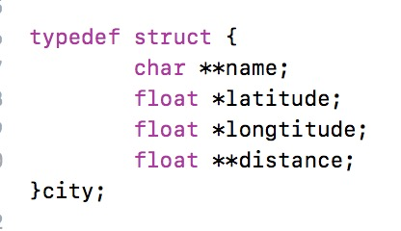
Part One
Algorithm: utilize the input file to calculate
flight distance between every two cities
Output is written into a distance file
Picture 1: Part of the algorithm

Slide 8
3. Part Two

Slide 9
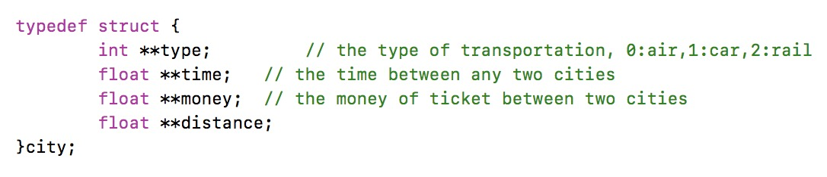
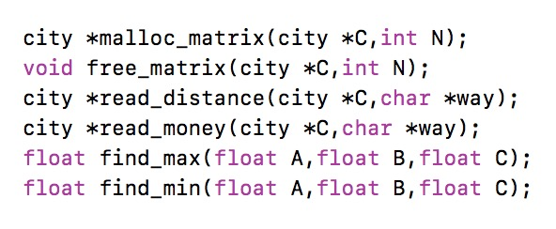
Part Two
Input file: distance_air, distance_car,
distance_train, money_air, money_car,
money_train
External parameter: weight
Algorithm: utilize the input file to choose a
suitable transportation method between two
cities
Output is written into a best distance file
Picture 2: Part of the algorithm

Slide 10
4. Part Three

Slide 11
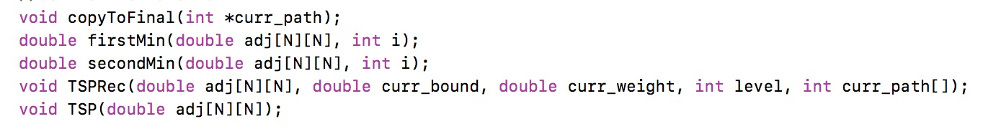
Part Three
Input file: best_distance
External parameter: number of cities to go traveling
Algorithm: utilize the input file to calculate a
shortest path for going through the whole cities
Output is a shortest path
Picture 3: Part of the algorithm

Slide 12
5. test, Analysis & Conclusion

Slide 13
Test & Analysis
Test : Use a small number of cities to generate several results of shortest path
Analysis: Input different weight of money and time cost to get a transportation method proportion

Slide 14
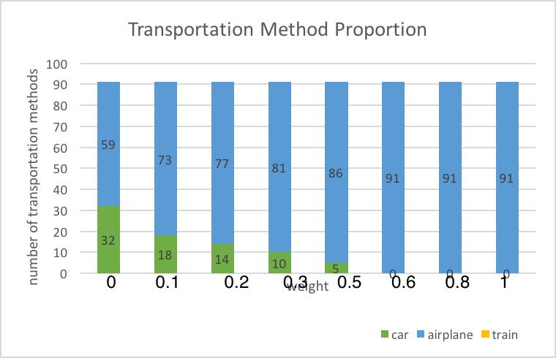
Conclusion
Table 2: Transportation Method Proportion

Slide 15
6. Progress

Slide 16
Progress
Finished Parts:
All algorithm and code
Test and analysis of program
Final Report

Slide 17
Thank you!

